Slide 1
Agenda for Music Data talk at USC
Who I am and how I got into music, and how my consumption was connected to tech – vinyl, cassette, cd, stream – and the industry itself – radio, record stores, guitar stores, sheet music, the library.
Converting from a fan to industry person and measuring all the activities of a person based on part one. Data was an inherent part of being a fan and a promo person as people use lists. How do people make decisions about music?
How music exists today as a data product, and if people make the lists then this is another example of “Data is People” – music business goals
The industry is set up as the apps vs. the content for the most part, and any time one goes into the other’s area, it can be perilous (Spotify signing artists, Sony Connect). Tech/app company goals
But there’s a glut of data, and we all share it. So streamers say to the content people, hire someone to go through this info and tell us what you find. Alignment of goals/tasks between music and data companies.
Mastery of the delivery and promotion process by labels who are still trying to master the technical and cultural aspects of hardcore data analysis. But as you now know, we are people who’ve been making lists since we are little kids and up for the challenge! What future problems can R help solve?

Slide 2
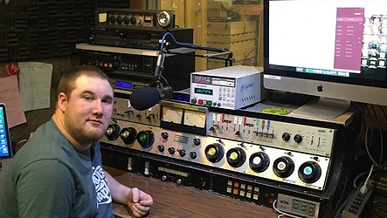

Slide 3
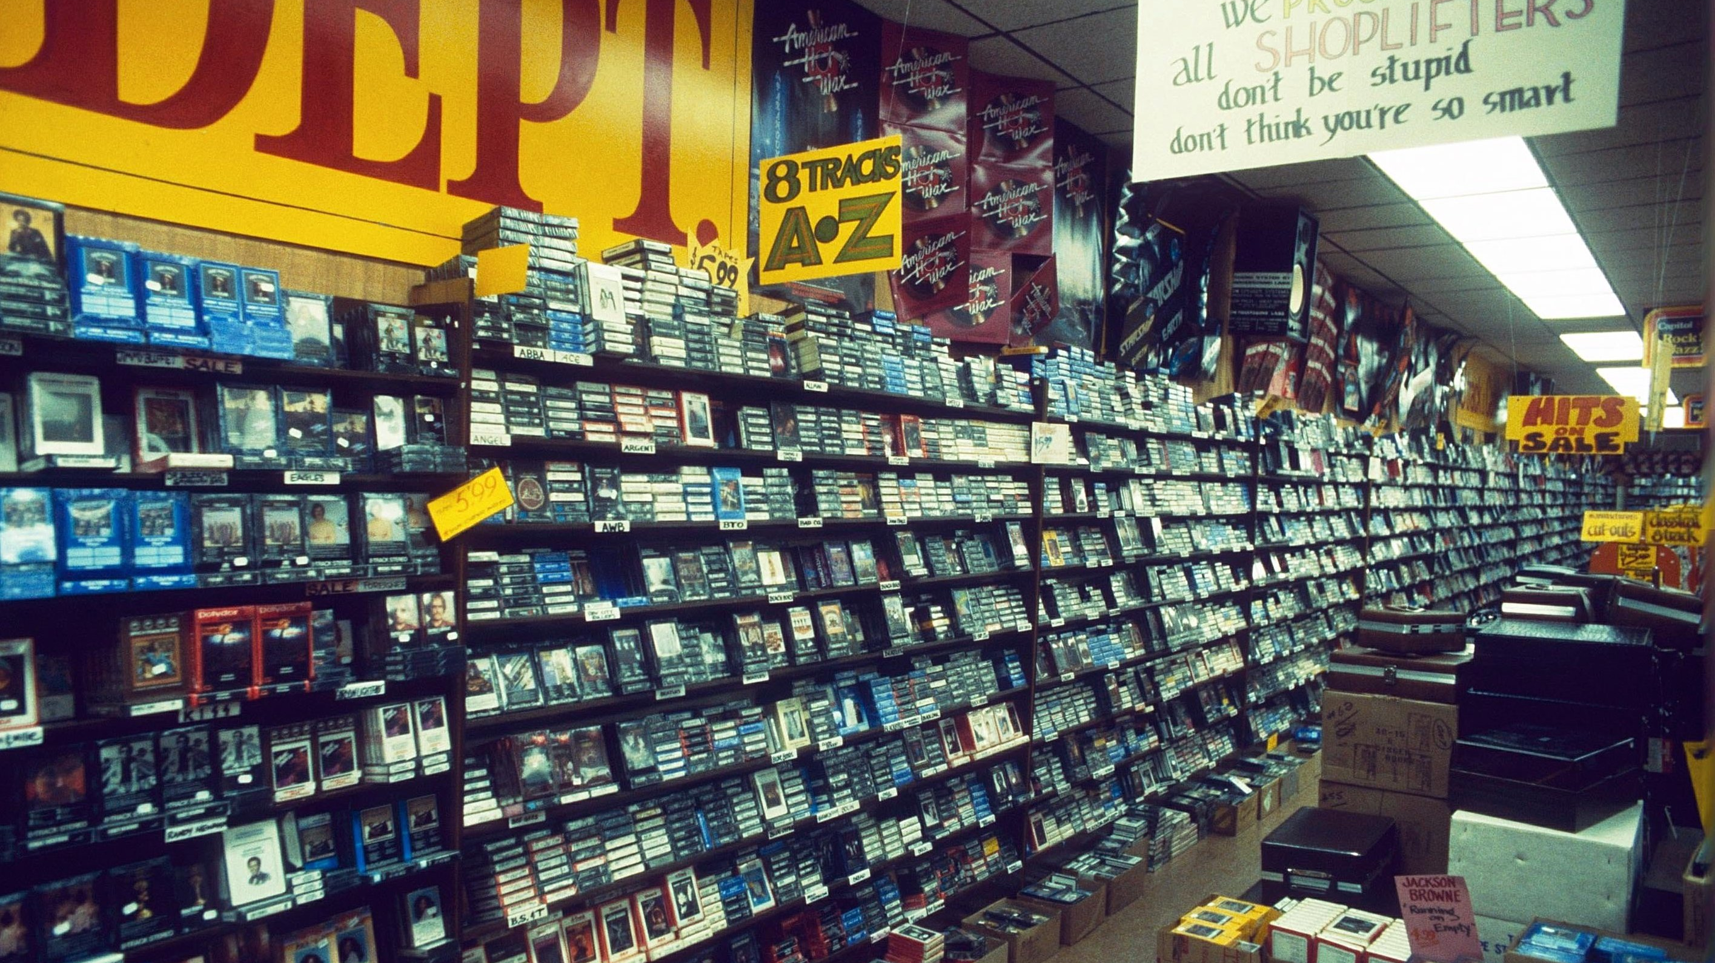

Slide 4
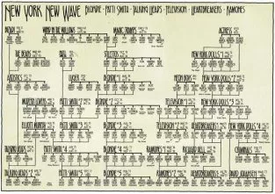

Slide 5

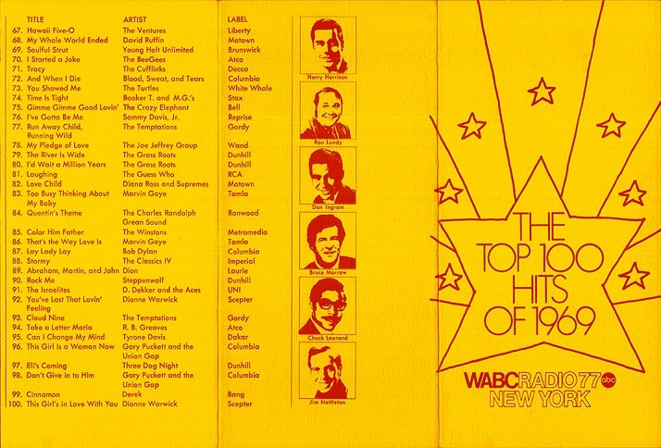
Lists of Songs – our guide as early fans
Notes:
You may have followed up on hearing the list on the radio station, but many of us started with something like this. And if you think about as a data person, we ‘got to know’ this data VERY well over time. Who appeared only one time? This Elton John guy has a lot of big songs…

Slide 6
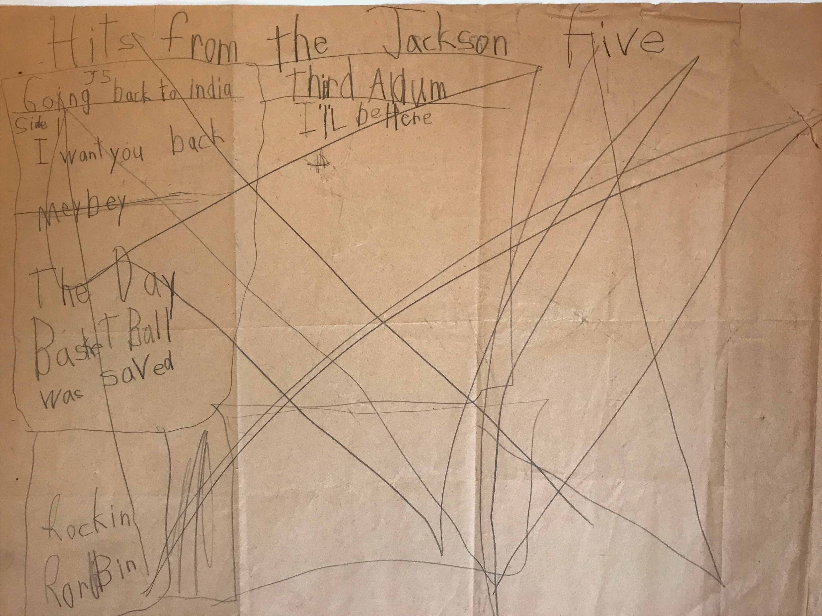
Our Own Lists of Songs
Notes:
My Shroud of Turin - a list of records made in 1972 when I was 6-7 years old. As soon as we start to take in data, we fit it to a “model.” This list shows my model had flaws – I didn’t remember all the songs I wanted to list. EVERY DATA BASE is built on a model of what that data shows in reality.

Slide 7
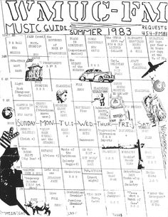
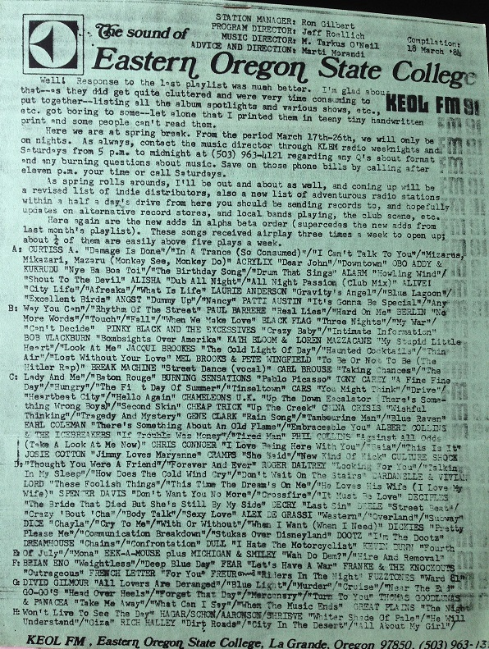
Compiling a Station Playlist
Notes:
Compiling/averaging all the music on a diverse, block-programmed college radio station to CREATE a “playlist” is data science – what is the mechanism for counting, deciding ties, etc. There’s a ton of human-decisions in this, and there should be. Data is people!

Slide 8
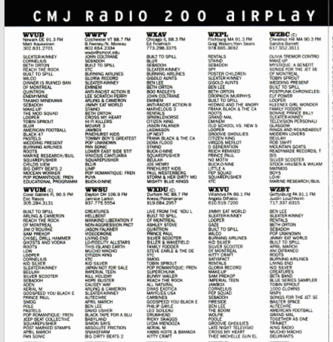
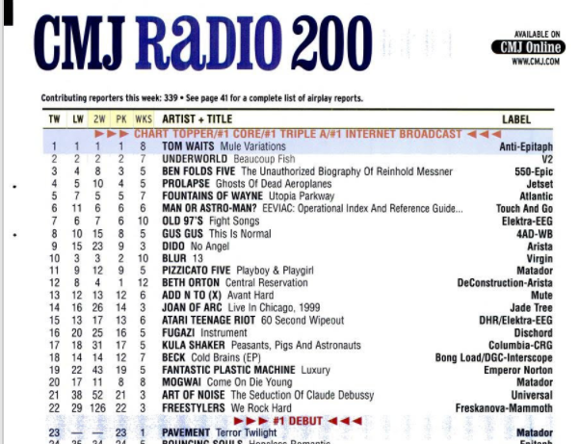
A Big List made up of Lists of Lists
Notes:
In promotion, the job is to herd all these lists on to the right artist in the right week, better than the other promo people.

Slide 9
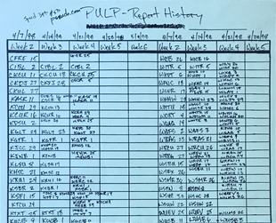

Comparing Lists of Lists
WPKN
WPBX
WNUR
WUSB
WXCI
WMBR
WXYC
WNYU
Notes:
Lists of lists – doing promotion and comparing lists of lists… my first data visualizations in music were Venn diagrams that enabled the folks working with me to immediately see how two records’ lists compared to each other.

Slide 10
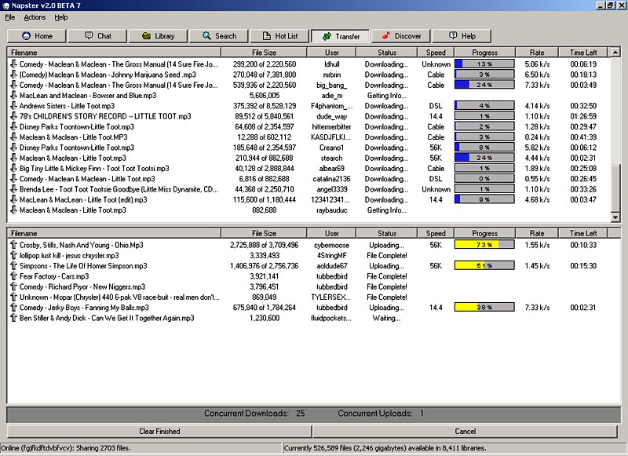
Napster, Limewire, Kazaa – FU
Notes:
The ultimate “list of records” was Napster. Made us realize that the whole history of music can be contained easily in a database. The industry changes brought on by Napster reduced work opportunities for people like me. So I got into data, and I was excited to see (next slide).

Slide 11
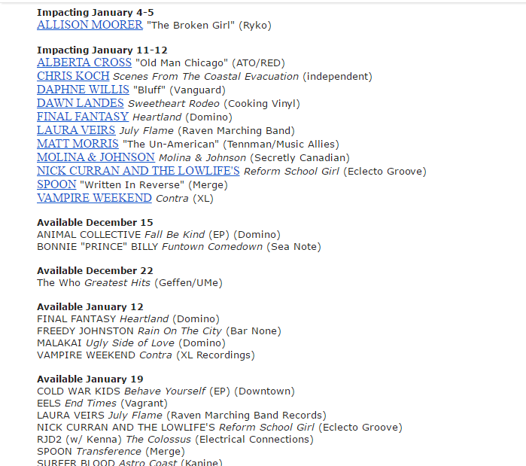
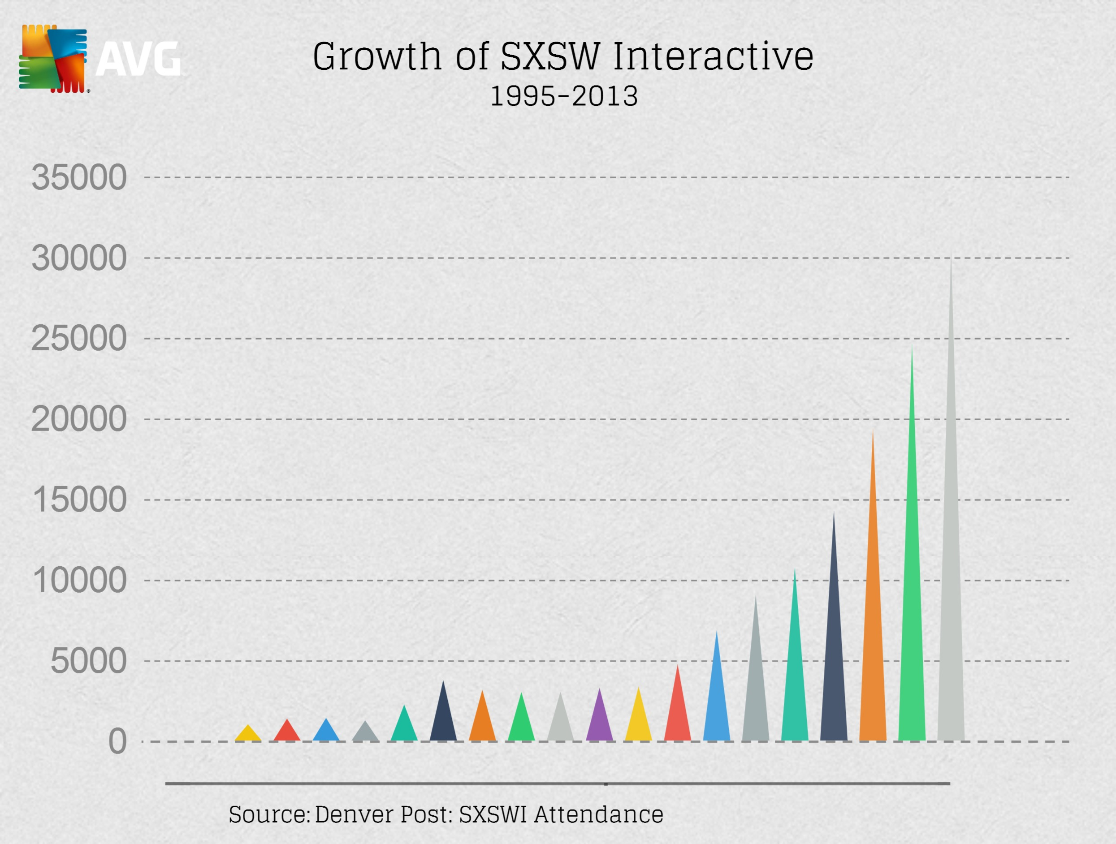
AAA Slows, SXSW Interactive Explodes
Notes:
Lists of releases getting smaller… but over here, social media, blogging, and tech in general are EXPLODING. And I think, I can do that… I’m already into this idea of multi-media, driving streams/traffic with social, etc. (Playing for Change on World Café in 2010. But the writing was on the wall…

Slide 12
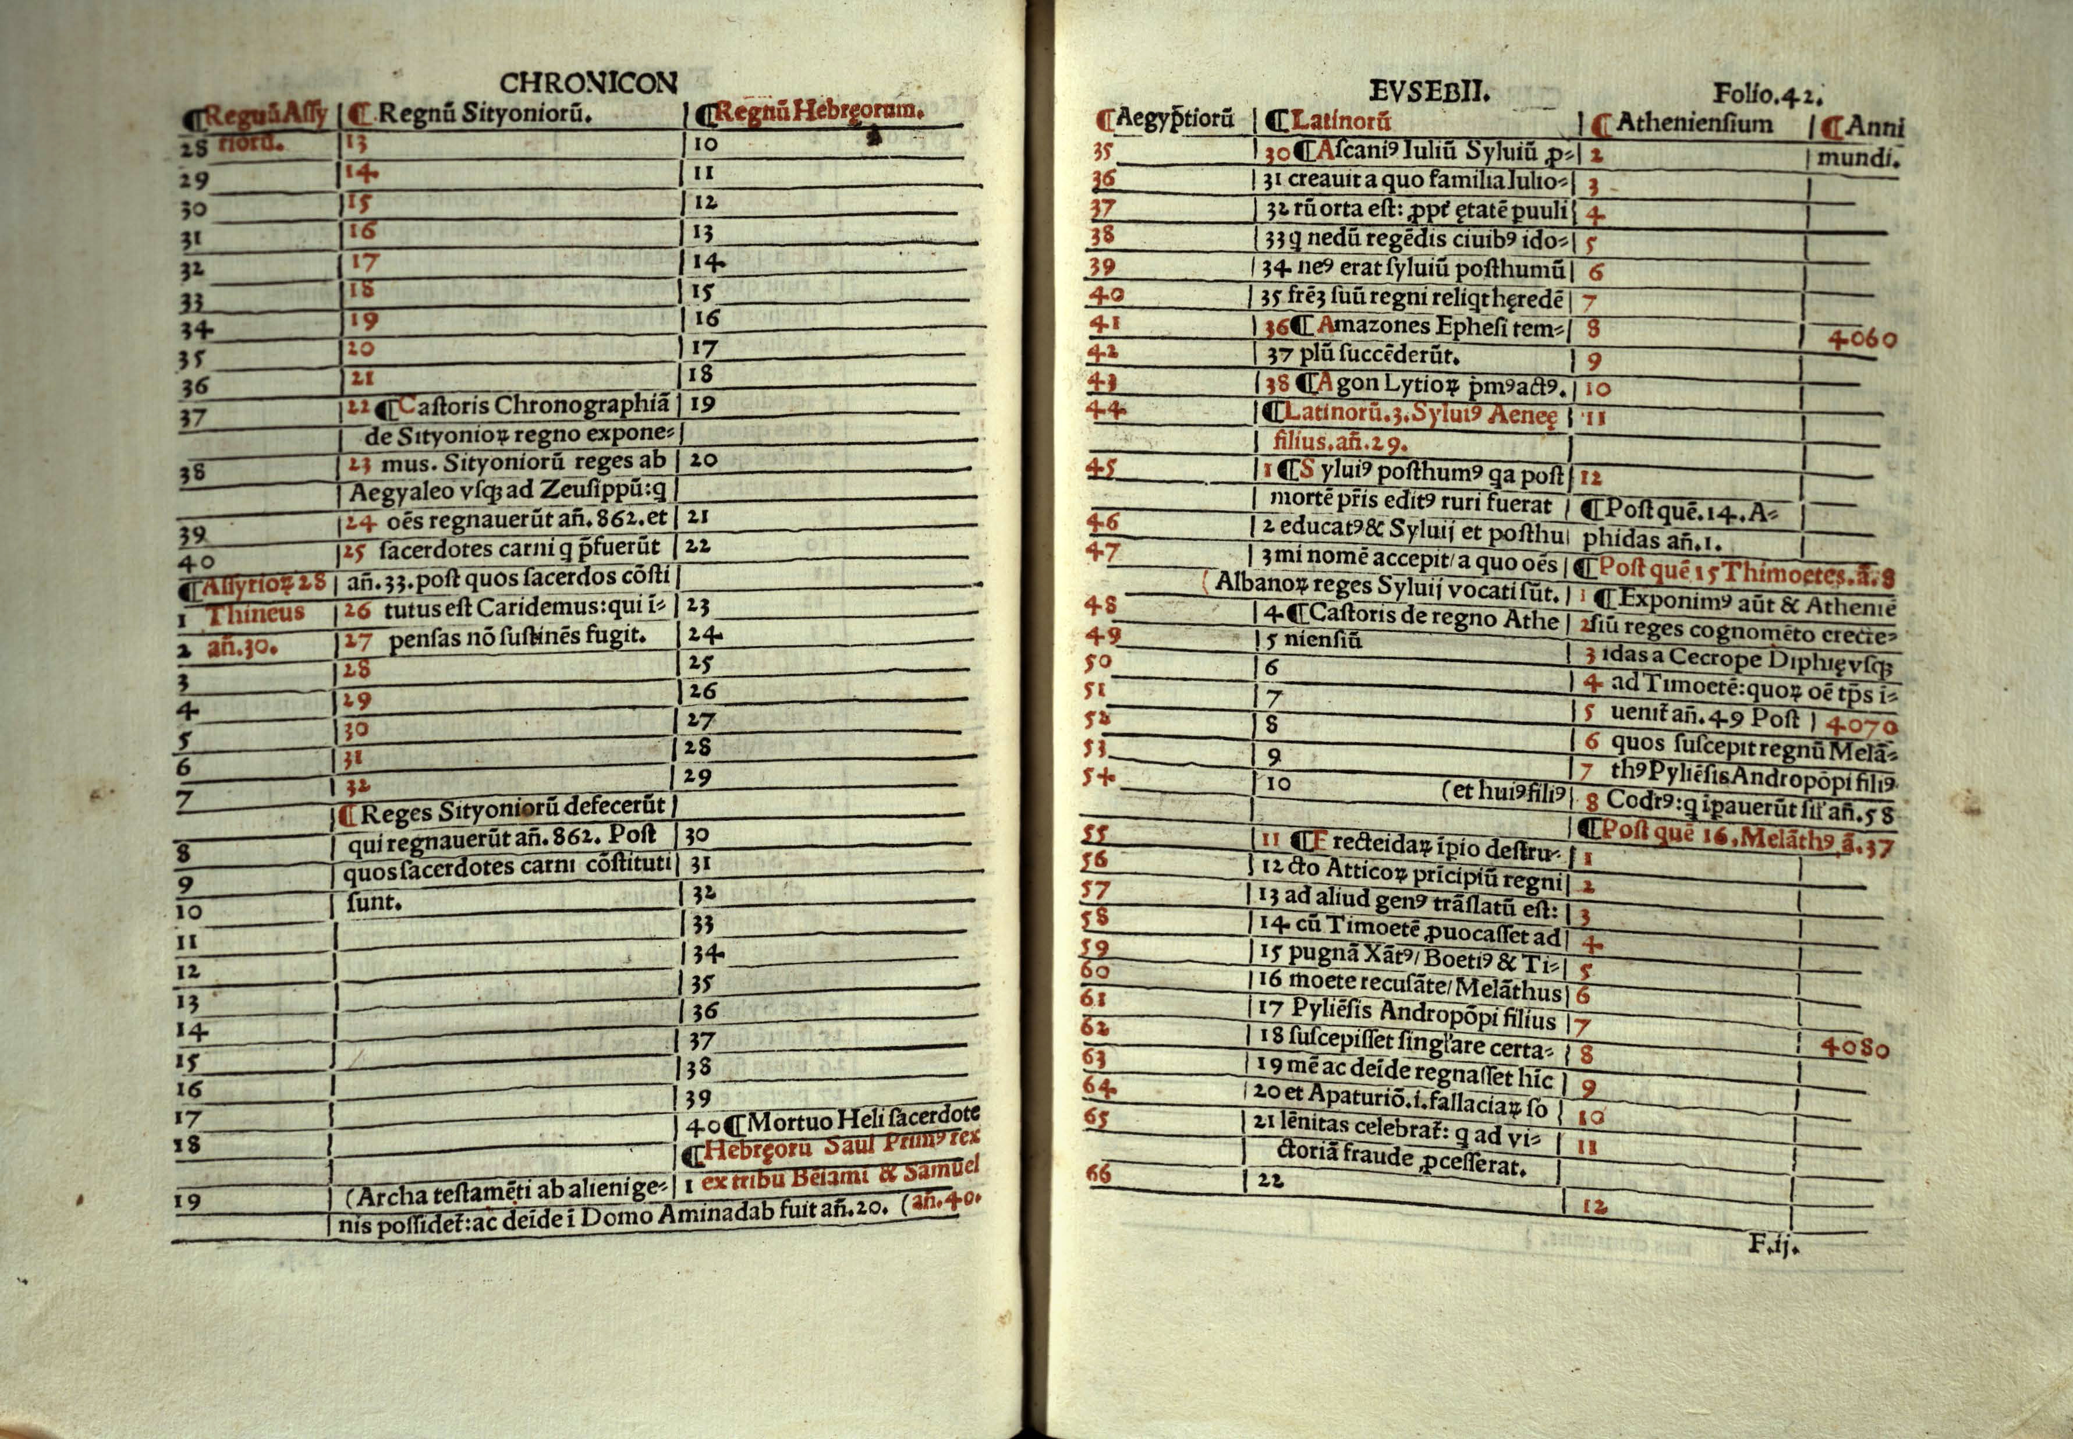
Civilization’s Oldest Tables
Notes:
As I got into data, the idea of two tables being compared came up again and again… this is one of the lightbulb moments. We are just dealing with tables, rows and columns, no matter what sort of strange idea (“bizarre mentation” as steely dan once said) or algorithm is going into creating this list. We each bring our own “model” to how we look at the world, and that subjectivity is often reflected in the data.

Slide 13
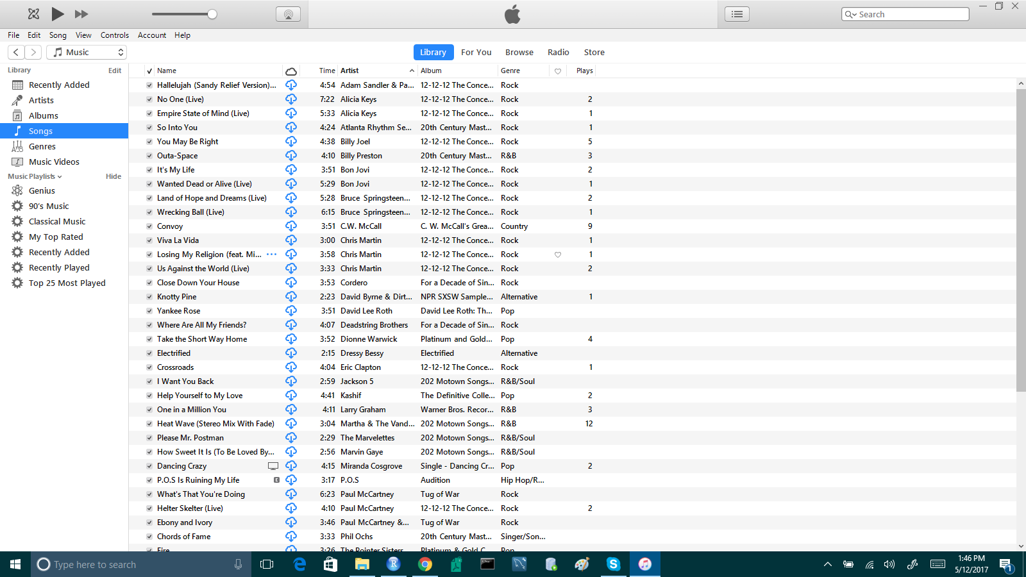
iTunes – Turns CDs into Data
When you search, sort, constrain, add an album cover, change spelling, etc. – you are interacting with a database that probably uses something like SQL on its ‘back end.’
Notes:
The industry is consumed by a special kind of “list of records.” Napster enables comparison of my version of the world with yours, instantaneously. But it’s still just lists of records.
And of course these lists of records had a big impact on the previous idea about lists and data. Now lists of records being released got smaller…

Slide 14
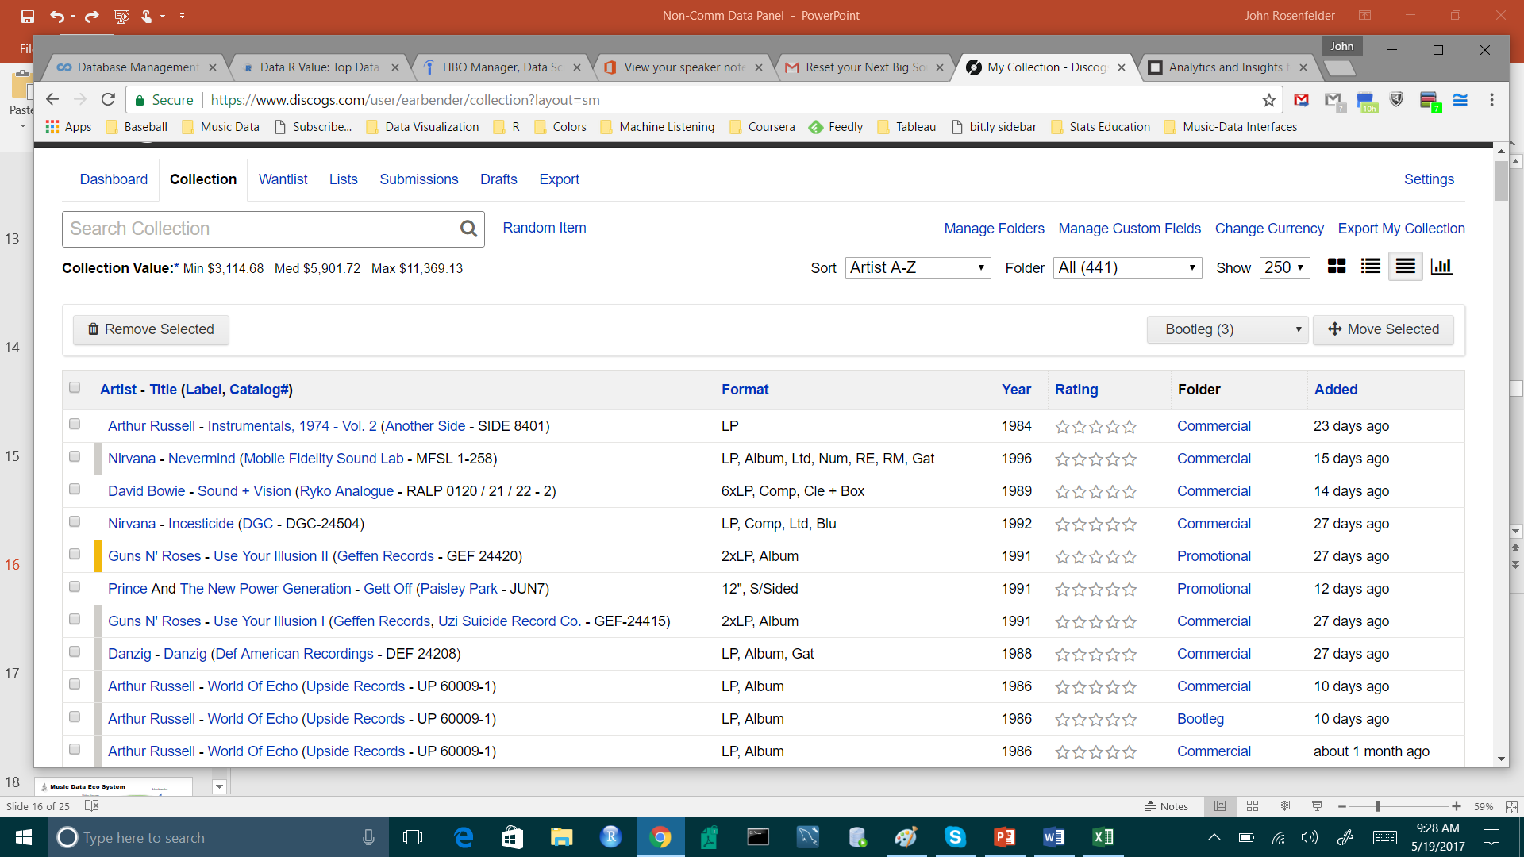
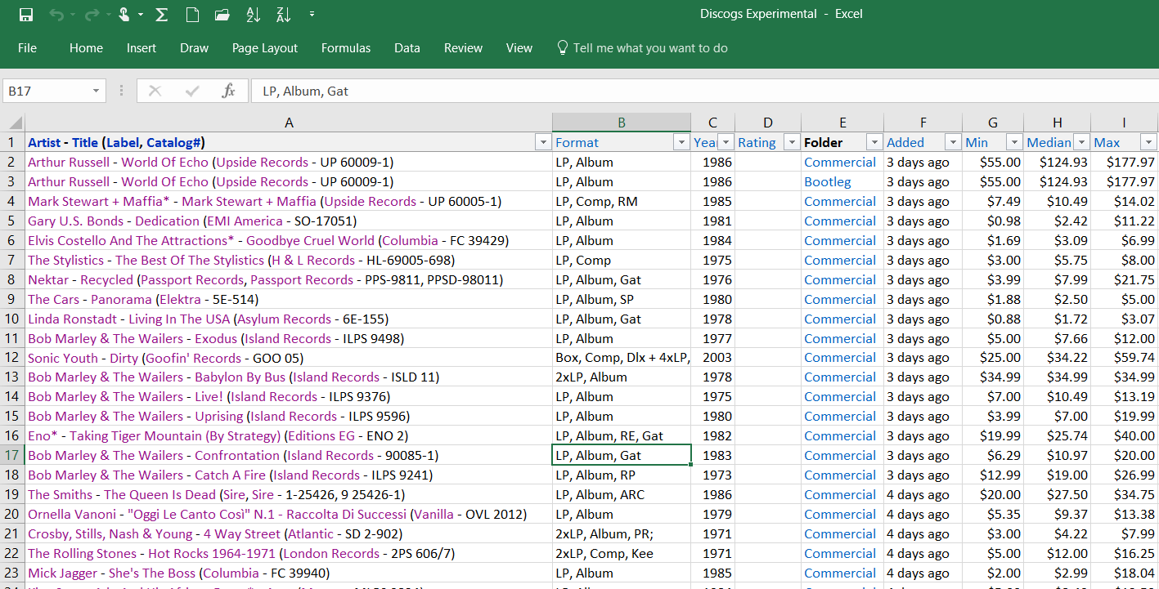
DISCOGS – Turns LPs into Data

Slide 15



Slide 16
Music Data Eco System
Merchandise
Video Streams
Sharing
Radio Spins
Fans/Listeners/Users
All encompassed by Social Media (and copyright?)
Brands
Sharing
Physical Sales
Audio Streams
Tickets
Syncs
Notes:
Transitioning from “Lists of Records” between B2B world and the B2C world, we are now into “Lists of Fans” and how to understand, influence and grow those lists.

Slide 17
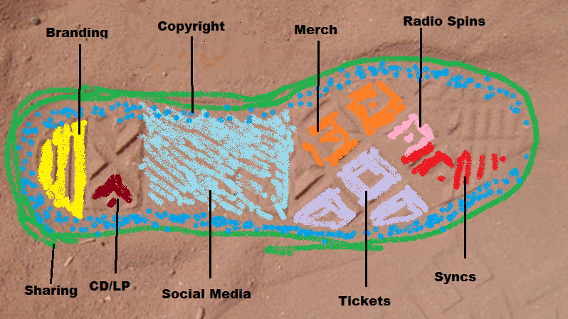
Notes:
Converse ‘footprint’ represents the size of a band’s audience/influence in a certain town.
Data and visualization - tools to resolve conflicts and reduce uncertainty for the best of the product/audience!
Labels and managers have access to data on most every project. Have them send you what will help from Facebook, YouTube, Twitter analytics pages; Next Big Sound (Screen shot); Spotify data; Shazam and others.
Third party sources such as Soundcharts, Spinitron, Rotten Tomatoes, Pandora, Amazon ranking
To establish a footprint (converse slide) like the Geiger/Tollette conversation…
Copyright hopefully has a similar binding force like social media. (or the music?)

Slide 18
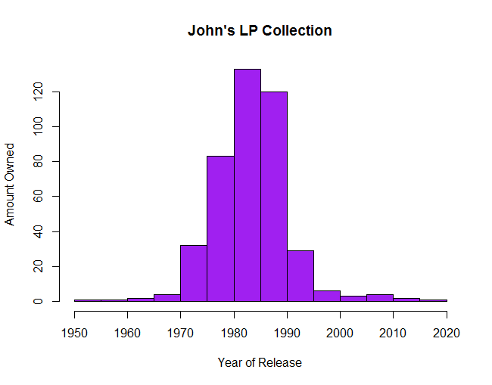
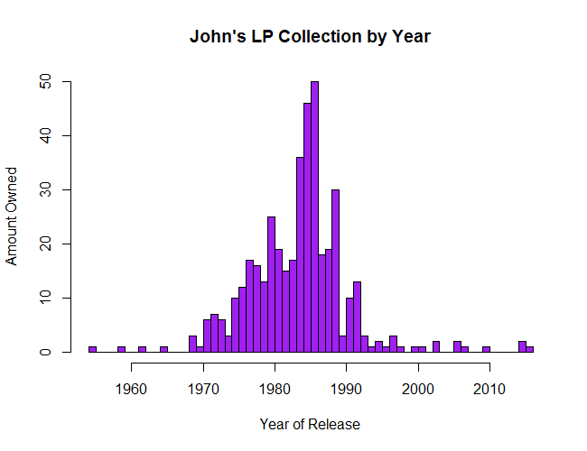
Data Visualization – DISCOGs Data
Notes:
And btw here’s a glimpse of my vinyl collection sorted by year. Is this a normal distribution with results centered around a median value of 1986 (MD at WUSB)? Or does it show a drastic decrease in spending/acquisition after 1981 and another in the early 90s? Different levels of detail in “bins” show different info. The Pre-1975 bin is skewed my brother’s albums. Purple for Prince, Red for the Cars. Made using Excel and R programming language/R Studio Interface (r-project.org). I show you this to remind you that DATA IS PEOPLE. You have to look at the granular info and put it into context if at all possible.
This analysis also shows the limitations of data – how could you know all the info above. It sure is relevant though. Small data is data that is too detailed or undetectable by computers. Always remember that data is people (spoiler alert)!

Slide 19
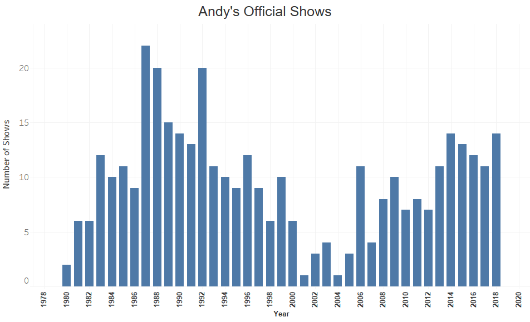

Slide 20
Measuring Fan Behavior – what should matter to music programmers and fans?
Traditional Music Metrics – Top Down programming
Streaming Music Metrics – On Demand and top down programming
Same ideas
Instead of by gut, ratings, sales and concert tickets
Time Spent Listening
Peak Musical Awareness
“Self Professed Experts in Recorded Music” (Bradley)
Done with apps and math
People program and massage playlists themselves by click with skips, saves, repeats even if they never make a playlist.
Still lots of gut, but a lot more data to use.
When you pitch a song at Spotify, they want to know about Radio!

Slide 21
How Radio Stations and Streaming Services Compete with each other
Recommendation – what is the missing data point, how can we best fill in that slot to “delight and surprise” like Whole Foods.
Price
Interface of the product
Sound Quality
Relationship with other apps/interfaces
Annotation and information around the data/songs themselves
What are some of the features people in the class think are differentiating?

Slide 22
Music Consumption Footprint by Age, Location, Gender – more and more granular subsets/conditions to target certain audiences and behaviors (only listens on weekends, selling products or tickets, exposing advertising as their job is to sell ads)

Slide 23
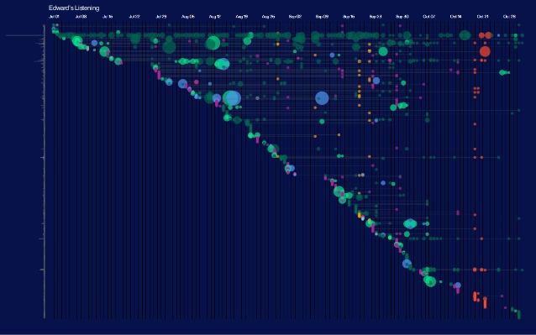
Spotify Usage Visualization (Edward Lee)
Notes:
Edward Lee Spotify presentation of user behavior at Plotcon.

Slide 24
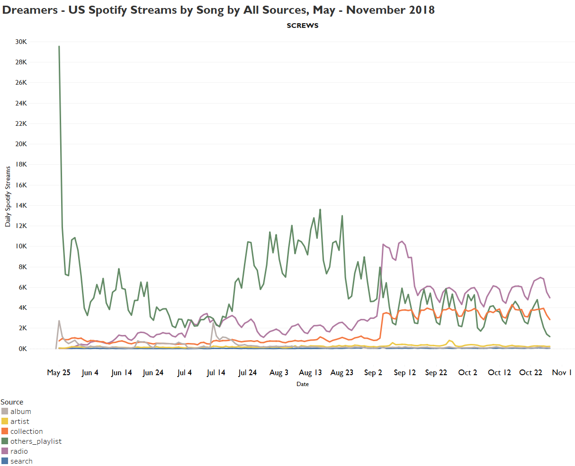

Slide 25
Finally some R!
R is open source and will be your friend in between jobs if you don’t have access to tableau, microstrategy, aws or a big database. And you can make your own data too.
Andy Stevens’ histogram of shows
John’s histogram of vinyl
Small multiples of Spotify streams by listening mode and radio market
R to showing dropoff of radio spins after radio concert
Paid subscribers by Streaming Service
TB Black Friday Sales; File cleanup for massive data sets very quickly
Shiny, Markdown and other means of sharing R Reports could be show if I get to that chapter.
How would students solve the problem of analyzing developing streams from a dot (one day) to a line (two days) to a trajectory?

